Slide 1
Why .NET Core and When to Use It
Making sense of the .NET Family

Slide 2

Intro
Will Tartak – President
Visual Data Solutions, Inc.
Been coding on MS tech since 1993
Been coding on .net since 1.0 (ca 2002)
Started first .NET Core project on 8/2016

Slide 3
Agenda
What is .NET Core?
Where does it fit in?
What changes has it caused?
What Platforms?
Which One?
Q & A

Slide 4
What is .NET?
Released in 2002
.NET is a general purpose development platform. It can be used for any kind of app type or workload where general purpose solutions are used. It has several key features that are attractive to many developers, as it combines high performance and richness with a unique, differentiated developer productivity.

Slide 5
What is .NET Core?
.NET Core is a general purpose, modular, cross-platform and open source implementation of .NET. It includes a runtime, framework libraries, compilers and tools that support a variety of chip and OS targets. These components can be used together or separately.
Sample list of major .NET Core 2.0 components:
Runtime
Libraries
.NET Standard
C#/VB compiler
F# compiler
SDK
CLI tools
NuGet
ASP.NET
MSBuild
Docker Images

Slide 6
What is Xamarin?
The Xamarin platform consists of a number of elements that allow you to develop applications for iOS and Android:
  C# language – Allows you to use a familiar syntax and sophisticated features like Generics, Linq and the Parallel Task Library.
  Mono .NET framework – Provides a cross-platform implementation of the extensive features in Microsoft’s .NET framework.
  Compiler – Depending on the platform, produces a native app (eg. iOS) or an integrated .NET application and runtime (eg. Android). The compiler also performs many optimizations for mobile deployment such as linking away un-used code.
  IDE tools – The Xamarin Studio IDE and the Xamarin in Visual Studio allow you to create, build and deploy Xamarin projects.
In addition, because the underlying language is C# with the .NET framework, projects can be structured to share code that can also be deployed to Windows Phone.

Slide 7
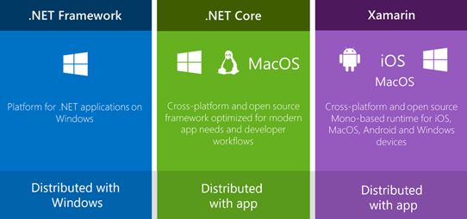
The .NET Family

Slide 8
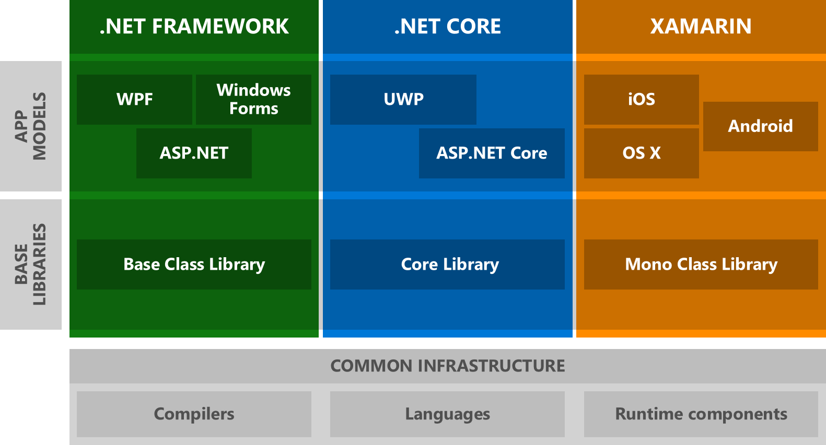
The Woven Web

Slide 9
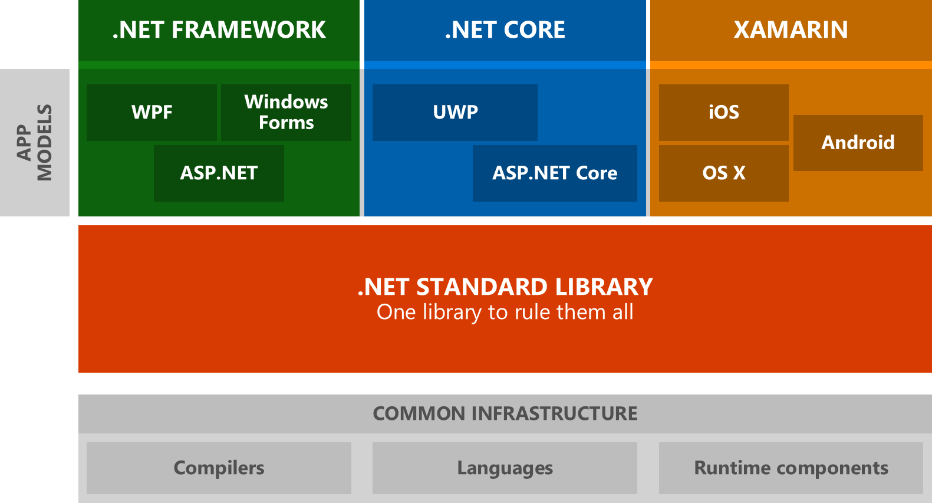
Give them Perspective

Slide 10
.NET Standard
Formal Spec (Contract) for .NET APIs
Replaces Portable Class Libraries (PCL)
Originally Part of .NET Core
Now The Standard – separate from all frameworks
Defines Reference APIs for all .NET Runtimes
Versioned as New APIs are added to the Spec, not the Runtime(s)
Currently 8 Versions Defined

Slide 11
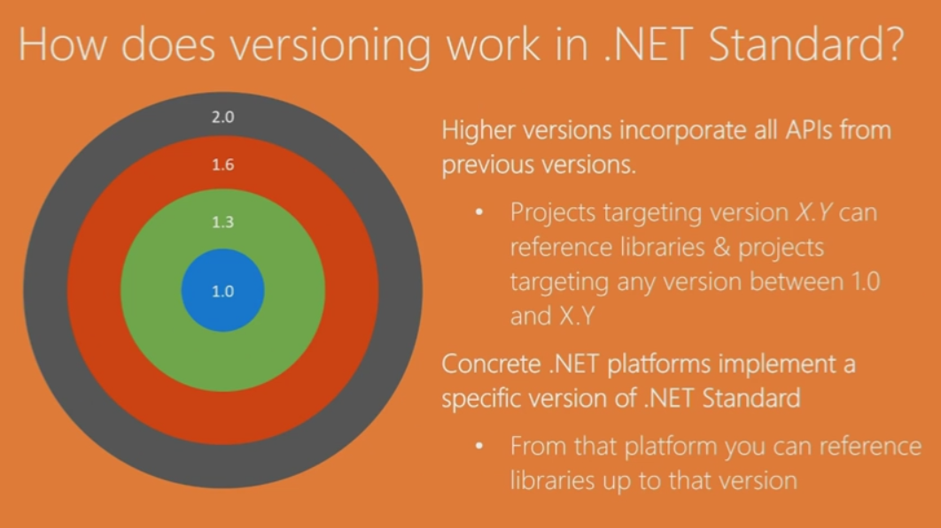

Slide 12
.NET Core Delivery Types
ASP.net Core (MVC6)
Universal Windows Platform (UWP)
Console App (exe)
Library (dll)

Slide 13
Cross Platform Distros
Red Hat Enterprise Linux 7.2
CentOS 7.1+
Debian 8.2+
Fedora 24
Linux Mint 17.1, 18
OpenSUSE 42.1
Oracle Linux 7.1
Ubuntu 14.04 & 16.04
Mac OS X 10.11, 10.12
Windows 7+ / Server 2012 R2+
Windows Nano Server TP5
Windows Server 2016

Slide 14
.NET Core Best Uses
Cross Platform
Microservices
Scalability
Consistent CLI Tools
Side by Side Execution with differing versions
UWP

Slide 15
Avoid .NET Core for…
Already in Production
  Consider .NET Core over full framework?
Need Desktop or other Full Framework Libraries (WPF, WCF, Workflow)
Need Existing, non .NET Standard Packages
Expect Tooling to be up to par
Aiming for Monolithic Application

Slide 16
Keep Full Framework for…
Proprietary Source
WinForms
WebForms
Visual Basic
SignalR
WPF

Slide 17
Avoid Full Framework for…
Cross Platform
Mobile (Xamarin)
New MicroServices
Open Source only

Slide 18
Xamarin Best Uses
Native Mobile Apps
Shared Codebase
  May save between 60 & 90% of second platforms code
Stay in .NET
Cross Platform
  iOS
  Android
  UWP
  MacOS

Slide 19
Xamarin Alternatives
Native per Platform
Javascript (Web based) Hybrid Apps
Browser Based Web App

Slide 20
Some Clarifications
.NET Core != .NetCore
.NET Core App not necessarily ASP.net Core
xproj & project.json are DEAD!
  Replaced by .csproj
.Net Standard 1.4 & 2.0 target full framework 4.6.1
  Avoid 1.5 & 1.6 or move away from them

Slide 21
Wrap Up
What is .NET Core?
Where does it fit in?
What changes has it caused?
What Platforms?
Which One?
Q & A

Slide 22
Thank You
willt@VisualDataSolutions.com
Github link to slides
Q & A

Slide 23
Resources (1)
https://apisof.net
https://github.com/dotnet/core/blob/master/roadmap.md
https://blogs.msdn.microsoft.com/cesardelatorre/2016/06/27/net-core-1-0-net-framework-xamarin-the-whatand-when-to-use-it/
https://oren.codes/2017/01/04/multi-targeting-the-world-a-single-project-to-rule-them-all/
https://github.com/dotnet/corefx/blob/master/Documentation/architecture/net-core-applications.md
https://blogs.msdn.microsoft.com/dotnet/2016/09/26/introducing-net-standard/

Slide 24
Resources (2)
https://github.com/Microsoft/dotnet-apiport
http://packagesearch.azurewebsites.net/
https://andrewlock.net/understanding-net-core-netstandard-and-asp-net-core/
https://oren.codes/2017/01/04/multi-targeting-the-world-a-single-project-to-rule-them-all/
https://github.com/aspnet/Performance

